Slide 1
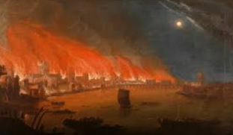
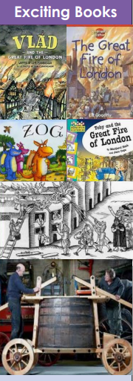
Bonfire Night and the Great Fire of London History Knowledge Mat
Subject Specific Vocabulary |  |  | Sticky Knowledge
Gunpowder Plot | The name given to the plot to blow up the Houses of Parliament in 1605 | Exciting Books to read: | Guy Fawkes attempted to carry out The Gunpowder Plot on 5th November 1605. He was attempting to blow up the House of Parliament and King James I. .
plot | A secret plan
 |  |  | The Gunpowder Plot was organised by Robert Catesby who was a Catholic
treason | The crime of betraying your country |  | Keeping healthy includes looking after our mental health. Doing things that we enjoy releases chemicals in our brains which make us happy.
 |  |  | The Gunpowder plot failed and all 13 involved were executed. We celebrate Bonfire Night to remember the failure of the plot.
Catholic | A member of the Catholic Church
Protestant | A Christian who belongs to the branch of the Christian Church that separated from the Catholic Church in the 16th century
Protestant | A shop selling meat |  | The Great Fire of London began on 2nd September 1666. It spread quickly because the houses were close together and made of wood. The fire appliances of the time could not cope with the fire.
Stuarts | The Stuarts reigned from 1603AD until 1714AD, more than a hundred years. At the time of the fire King Charles the second was king.
Pudding Lane | The street where the fire started
High Street | A line of shops selling everyday items |  | The fire lasted for 4 days and destroyed large areas of London, making thousands of people homeless. It began on 2nd September 1666AD
Thames | The river that runs through London and where the firefighters got water from. |  | Our grandparents went into shops to buy things, home delivery and internet shopping had not been invented. Some people used greengrocers, bakeries and butchers rather than supermarkets.
Balanced diet | A diet that has foods from the five different food groups – starchy food, protein, dairy, fruit and vegetables, oils and fats |  | A man called Samuel Pepys kept a diary of the events and that is one of the reasons we know about what happened.
bakery | The shop where the fire started. Thomas Farynor, the owner, said he had put out the fires in the ovens before he left the bakery.
 |  |  | The fire started in a bakery in Pudding Lane in London. The bakery belonged to Thomas Farynor.

