Slide 1
Meet the teacher Kingfisher Class
September 2024

Slide 2
The adults in Owl Class
Mrs Lewis – Class teacher
Mrs Price/ Miss Deighton/Miss Workman – Classrooom assistants
Miss Law – SEN assistant and PPA teacher (Monday PM)
Mr J - PE teacher

Slide 3
A little bit of background to me…
I have been teaching in Gloucestershire and Wiltshire for the last 13 years in a variety of schools.
I have experience teaching all years groups, from EYFS to Year 6 including mixed aged classes.
Outside of school, I have three sons.

Slide 4
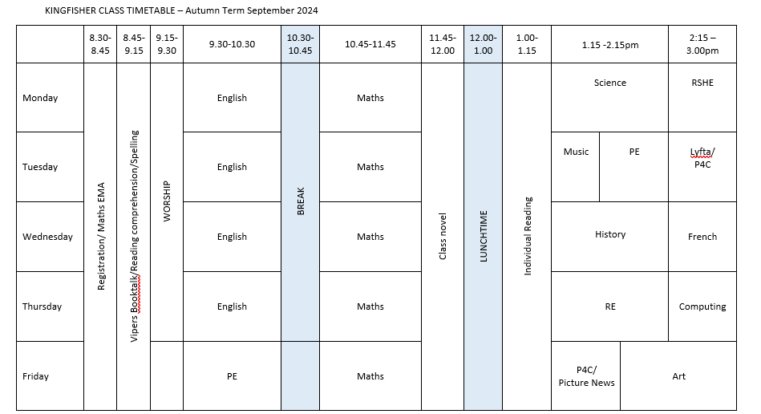
Weekly Timetable

Slide 5
Maths
3 part lessons – fluency, problem solving and reasoning
Basics are vital – number bonds for speedy arithmetic
Times tables need to be secure
Flashback maths, Maths Skills consolidation
Main lesson in White Rose maths book with additional ‘Prove it’ tasks in books
TT rock stars

Slide 6
English
We use ‘The Write Stuff’ which equips children with all the skills they need to write across all genres.
3 part lesson – word and phrase collecting; modelling by teacher; child writing.
Sentences are shared and ‘stacked’ in the class. This supports children with the knowledge and experience they need to construct paragraphs and full texts.
We also teach discreet grammar lessons to ensure full coverage of the curriculum.

Slide 7
Reading
Please read with your child each night and record this in your child’s reading record. We also use this book so that you can see when they read in school as well.
Books from school are chosen and set according to ‘Star Reader’ ZPD reading levels.
Children need to complete a book every fortnight and complete an Accelerated Reader quiz at school when they have done so.
Please read books to your child that they could not read themselves. Research shows this is vital to later comprehension.
We follow Literacy Shed Plus (VIPERS) for our reading comprehension tool.

Slide 8
Homework
Reading - this is the most important! Please keep it up.
Homework will be sent home weekly in a book. This will go out on a Tuesday to be returned every Monday.
Spellings: Each week, your child will receive 10 spellings to practise. These spellings will come home on a Friday, be practised through the week and will be tested on the following Friday. Spelling books will need to be returned to school on Friday.
Tables: By the end of Year 4, children are expected to know all of their multiplication and division facts up to 12 x 12 and 144 ÷ 12. To support with this, each week, your child will have a multiplication table or division table to practise. This will come home on a Friday, should be practised through the week and must be returned on the following Friday
Each year group has a number of key skills to be mastered. We have split these up into termly lists and children will need to practise these weekly as their maths homework. These lists are referred to as KIRFS ( Key Instant Recall Facts)
Knowledge organiser – this is a useful document to share with your child and discuss what they have learnt.

Slide 9
Celebrating Success
Every week we have a Celebration Worship where selected children are awarded the Star of the Week certificate. This might be for academic achievement, good progress, perseverance, a WOW moment or going above and beyond to help another child.
When we spot one of our Christian values being enacted children are awarded with a special certificate to recognise when they have been kind, courageous, respectful, curious etc
Every so often we give out our most special award – The Socks Off Award. This award is given to a child when we have seen them consistently working their socks off . In school this would look like: always trying their best in all lessons; persevering when things got hard; and being a role model for the school consistently. We also require children to demonstrate that they are working hard at home, completing all homework, reading daily, practising their KIRFS in maths etc. The children receive a pair of special socks, a certificate and the biggest round of applause of them all!

Slide 10
Partnership
Children are all individuals
Talking through worries and concerns is important. Please do not hesitate to ask, the earlier we know about a concern, the easier it is to resolve.
I am available at the end of the day
Parents evening will be before half term
If the matter is urgent and I am not available, please leave a message with the office or with another member of staff. If you have an urgent message in the morning please email the admin account admin@northcerney.dgat.org.uk or leave a message with the member of staff on duty in the playground. Teachers are generally unavailable at the start of the day as they are busy setting up learning.
If you are unexpectedly delayed picking up your child, please telephone the school and your child can have a place in our after school club until you arrive.

Slide 11
Behaviour
We have been in discussions with the children over the past year about behaviour, friendships and bullying. We ask you to encourage children to talk to adults in school about anything that bothers them so that we are able to support them immediately.
We explore the issue of bullying regularly with the children and stress the importance in knowing how to define bullying. It is when there is repetitive, intentional hurting of one person or group by another person or group.
Please let us know if you would like additional information about our policies regarding this or if you would like extra support in this area.

Slide 12
Reminders
Your child will need to have their PE kit at school this term as we have PE on Tuesdays and Fridays.
Reading records and books need to be returned daily.
Wellies – please name!
Please ensure that your child has a warm coat and appropriate school shoes (or sun hat and sun cream depending on the weather!)
Please ensure that you label all school clothes with your child’s name. We can waste valuable learning time trying to return unnamed clothing.
Please ensure that your child has a water bottle filled with water every day.
Snack time (please send actual fruit or vegetables – not fruit winder type snacks)
Thank you! If you have any concerns, please contact the office to arrange an appointment – I am happy to help with any learning or any settling in issues you may need to discuss concerning your child.

