Slide 1
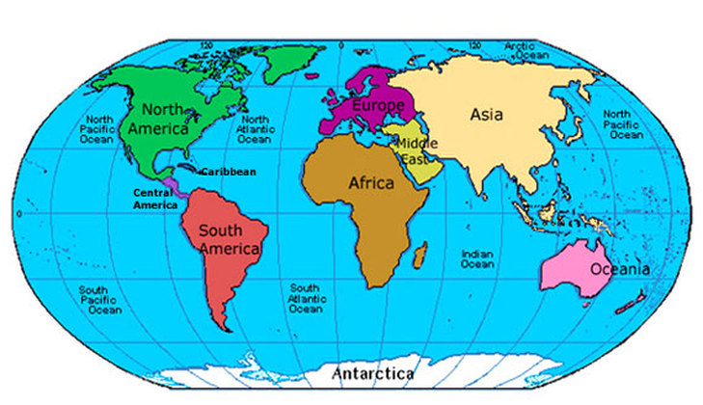
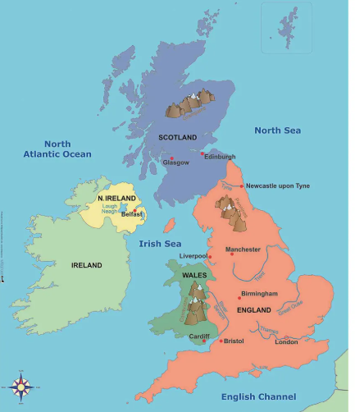
People and their Communities Knowledge Mat
Subject Specific Vocabulary |  |  | Sticky Knowledge about maps and fieldwork
 |  | nit:
 |  |  | I can identify where we live within the UK and the world on a map.
 |  |  | I know the seas that surround the UK: in the South there is the English Channel; to the East there is the North Sea, to the west there is the Irish Sea and the Atlantic Ocean.
Capital city | London is the capital city of the United Kingdom. A capital city is where the government of a country is based. |  | I know that a map gives us an aerial view of our world I can make a simple map of our surrounding area and its immediate features
 |  |  | The Amazon Rainforest is in the continent of South America in a country called Brazil.
landmark | an object or feature of a landscape or town that is easily seen and recognized from a distance, especially one that enables someone to establish their location
 |  |  | In parts of Africa some buildings are made from mud.
coast | The part of the land adjoining or near the sea.
 |  |  | New York is a large city in the USA, Beijing is a large city in China and Sydney is a large city in Australia.
rainforest | A thick forest found in hot, wet areas of the world
 |  |  | I know that North Cerney is a village and I can talk about the physical and human features of the area using the following terms : River, stream, wood, field, valley, hills, All Saints’ Church, Cerney House, The Bathurst Arms, post office, town
villages | These are small places which are home to a few hundred people. Some villages have a shop but some do not.
Continent | any of the world's main continuous expanses of land (Europe, Asia, Africa, North and South America, Australia, Antarctica).

